Slide 1


Slide 2
Examples’ Source Code
Source Code for examples presented in these slides can be found on:
Blackboard->Course Content->Source Code Of The Book Examples

Slide 3
Module 16 Topics
Module 16 discusses the following main topics:
10.1 - What Is Inheritance?
10.2 - Calling the Superclass Constructor
10.3 - Overriding Superclass Methods
10.4 - Protected Members
10.5 - Chains of Inheritance
10.6 - The Object Class
10.7 - Polymorphism
10.8 - Abstract Classes and Abstract Methods

Slide 4
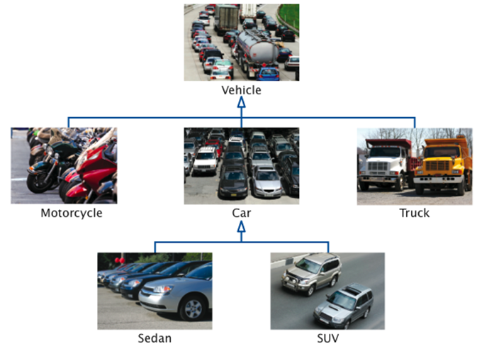
What is Inheritance? Generalization vs. Specialization
Real-life objects are typically specialized versions of other more general objects.
Vehicle
Car

Slide 5
What is Inheritance? Generalization vs. Specialization
Inheritance is an
“is-a” relationship.
A car “is-a” vehicle
Composition is a
“has-a” relationship.
A car “has-a” tire.

Slide 6
What is Inheritance? Generalization vs. Specialization
Another Example:
The term “insect” describes a very general type of creature with numerous characteristics.
Grasshoppers and bumblebees are insects
They share the general characteristics of an insect.
However, they have special characteristics of their own.
grasshoppers have a jumping ability, and
bumblebees have a stinger.
Grasshoppers and bumblebees are specialized versions of an insect.

Slide 7
Inheritance
Insect
Contains those attributes and methods that are shared by all insects.
BumbleBee
Grasshopper
Contains those attributes and methods that specific to a Bumble Bee.
Contains those attributes and methods that are specific to a Grasshopper.

Slide 8
The “is a” Relationship
The relationship between a superclass and an inherited class is called an “is a” relationship.
A grasshopper “is a” insect.
A poodle “is a” dog.
A car “is a” vehicle.
A specialized object has:
all of the characteristics of the general object, plus
additional characteristics that make it special.
In object-oriented programming, inheritance is used to create an “is a” relationship among classes.

Slide 9
The “is a” Relationship
We can extend the capabilities of a class.
Inheritance involves a superclass and a subclass.
The superclass is the general class and
the subclass is the specialized class.
The subclass is based on, or extended from, the superclass.
Superclasses are also called base classes, and
subclasses are also called derived classes.
The relationship of classes can be thought of as parent classes and child classes.

Slide 10
Inheritance
The subclass inherits fields and methods from the superclass without any of them being rewritten.
New fields and methods may be added to the subclass.
The Java keyword, extends, is used on the class header to define the subclass.
public class FinalExam extends GradedActivity

Slide 11
The GradedActivity Example
GradedActivity
Contains those attributes and methods that are shared by all graded activities.
- score : double
+ setScore(s : double) : void
+ getScore() : double
+ getGrade() : char
Contains those attributes and methods that are specific to the FinalExam class.
Inherits all non-private attributes and methods from the GradedActivity class.
FinalExam
- numQuestions : int
- pointsEach : double
- numMissed : int
Example:
GradedActivity.java,
GradeDemo.java,
FinalExam.java,
FinalExamDemo.java
+ FinalExam(questions : int,
missed : int)
+ getPointsEach() : double
+ getNumMissed() : int

Slide 12
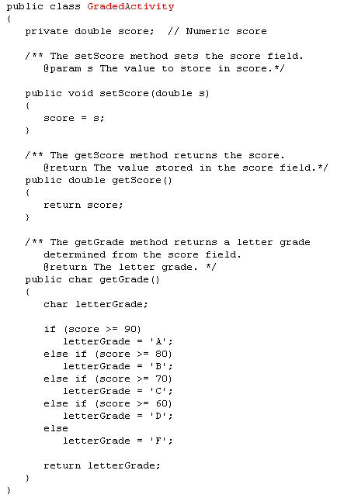
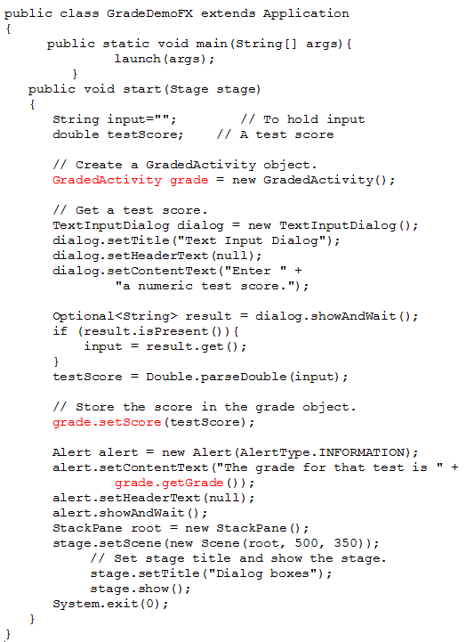
GradedActivity
- score : double
+ setScore(s : double) : void
+ getScore() : double
+ getGrade() : char

Slide 13
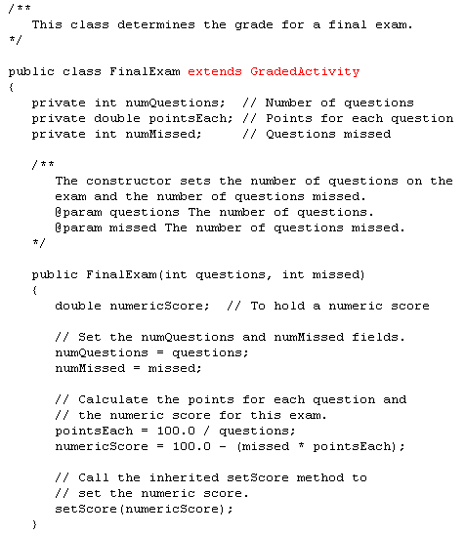
GradedActivity
- score : double
+ setScore(s : double) : void
+ getScore() : double
+ getGrade() : char
FinalExam
- numQuestions : int
- pointsEach : double
- numMissed : int
+ FinalExam(questions : int,
missed : int)
+ getPointsEach() : double
+ getNumMissed() : int

Slide 14
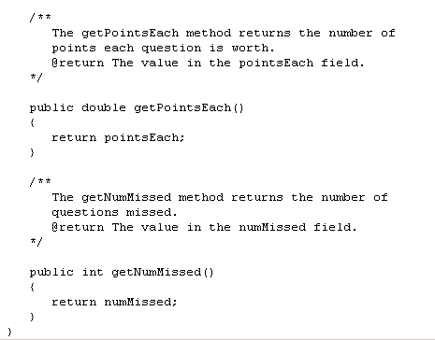
GradedActivity
- score : double
+ setScore(s : double) : void
+ getScore() : double
+ getGrade() : char
FinalExam
- numQuestions : int
- pointsEach : double
- numMissed : int
+ FinalExam(questions : int,
missed : int)
+ getPointsEach() : double
+ getNumMissed() : int

Slide 15
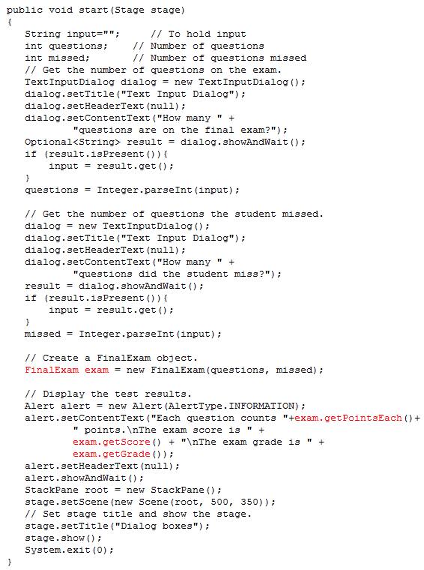
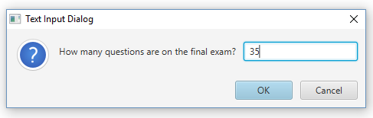
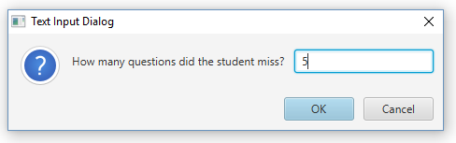
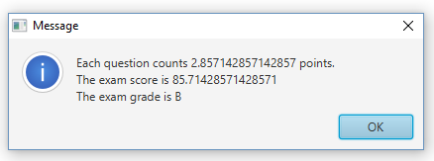
FinalExamDemo

Slide 16
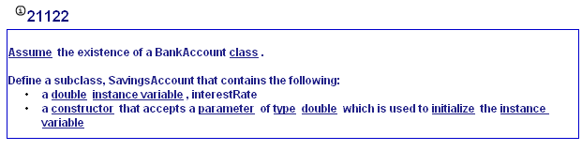
My Programming Lab 9 – 10.1

Slide 17
Inheritance, Fields and Methods
Members of the superclass that are marked private:
are not directly accessible by the subclass,
exist in memory when the object of the subclass is created
may only be accessed from the subclass by public methods of the superclass.
Members of the superclass that are marked public:
are inherited by the subclass, and
may be directly accessed from the subclass.

Slide 18
Inheritance, Fields and Methods
When an instance of the subclass is created, the non-private methods of the superclass are available through the subclass object.
FinalExam exam = new FinalExam();
exam.setScore(85.0);
System.out.println("Score = " + exam.getScore());
Non-private methods and fields of the superclass are available in the subclass.
setScore(newScore);

Slide 19
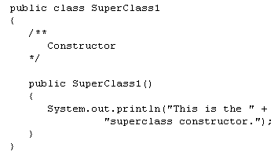
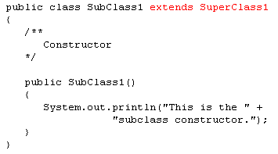
Inheritance and Constructors
In client:
SubClass1 sub = new SubClass1();
Constructors are not inherited.
When a subclass is instantiated, the superclass default constructor is executed first.

Slide 20
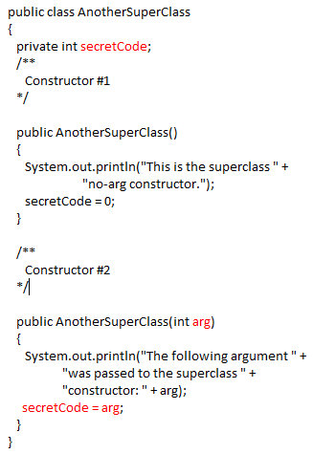
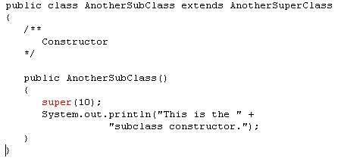
The Superclass’s Constructor
The super keyword refers to an object’s superclass.
The superclass constructor can be explicitly called from the subclass by using the super keyword.
How else could the secretCode in AnotherSuperClass be set?
AnotherSuperClass would have to have a setter for secretCode

Slide 21
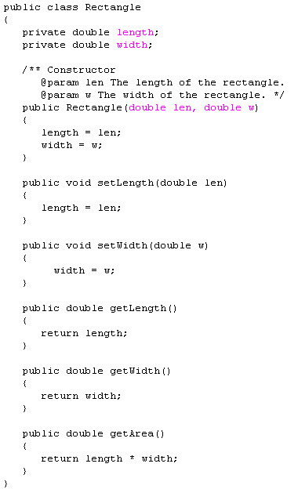
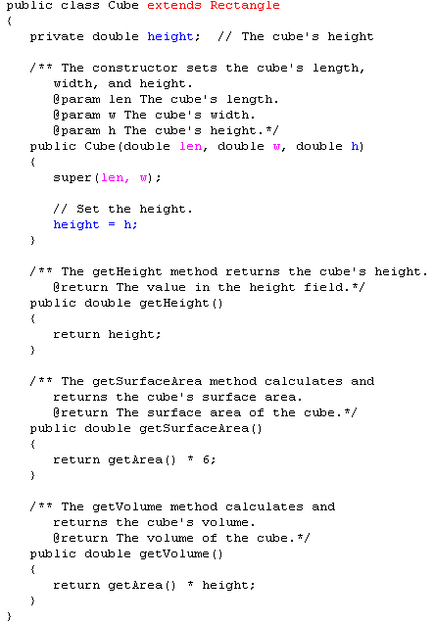
Draw the UML diagram

Slide 23
Calling The Superclass Constructor
If a parameterized constructor is defined in the superclass,
the superclass must provide a no-arg constructor, or
subclasses must provide a constructor, and
subclasses must call a superclass constructor.
Calls to a superclass constructor must be the first java statement in the subclass constructors.

Slide 24
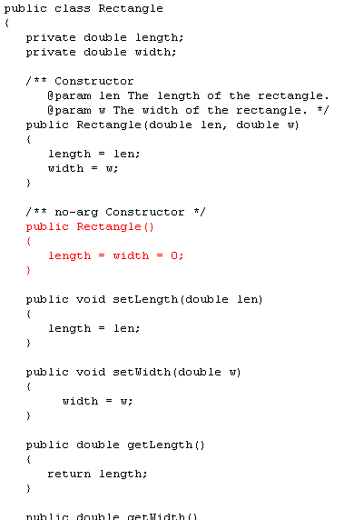
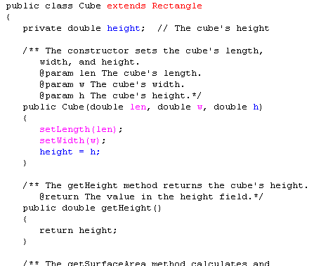
To be safe, always provide
a no-arg constructor for
your classes

Slide 25
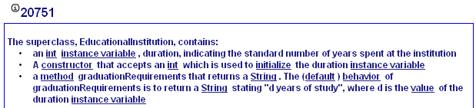
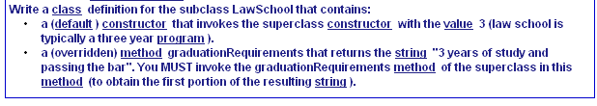
My Programming Lab 9 – 10.2

Slide 26
Overriding Superclass Methods
A subclass may have a method with the same signature as a superclass method.
The subclass method overrides the superclass method.
This is known as method overriding.
Example:
GradedActivity.java, CurvedActivity.java, CurvedActivityDemo.java

Slide 27
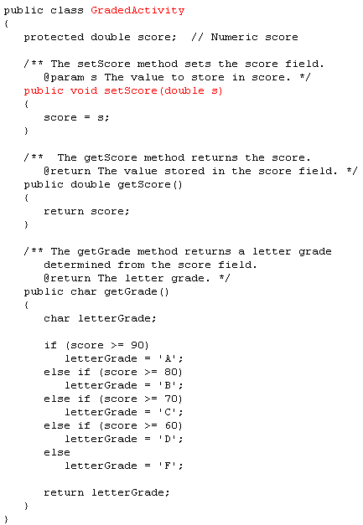
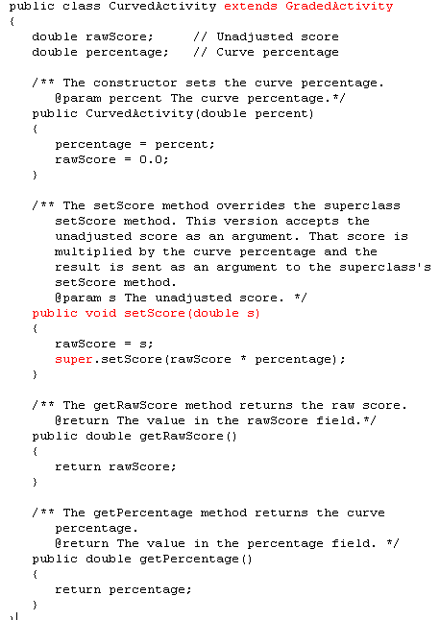

Slide 28
Overriding Superclass Methods
GradedActivity
- score : double
+ setScore(s : double) : void
+ getScore() : double
+ getGrade() : char
This method is a more specialized version of the setScore method in the superclass, GradedActivity.
CurvedActivity
- rawScore : double
- percentage : double
+ CurvedActivity
(percent : double)
+ setScore(s : double) : void
+ getRawScore() : double
+ getPercentage() : double

Slide 29
Overriding Superclass Methods
Recall that a method’s signature consists of:
the method’s name
the data types method’s parameters in the order that they appear.
A subclass method that overrides a superclass method must have the same signature as the superclass method.
An object of the subclass invokes the subclass’s version of the method, not the superclass’s.

Slide 30
Overriding Superclass Methods
An subclass method can call the overridden superclass method via the super keyword.
super.setScore(rawScore * percentage);
There is a distinction between overloading a method and overriding a method.
Overloading is when a method has the same name as one or more other methods, but with a different signature.
Overriding is when a method has the same name as an inherited method, but with the same signature.

Slide 31
Overriding Superclass Methods
Both overloading and overriding can take place in an inheritance relationship.
Overriding can only take place in an inheritance relationship.
Example:
SuperClass3.java,
SubClass3.java,
ShowValueDemo.java

Slide 32
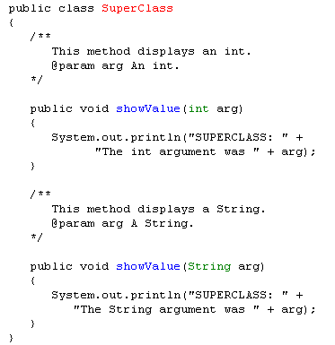
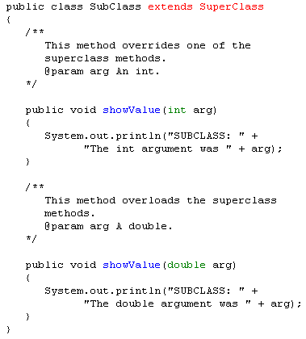
SuperClass
In client:
Subclass sub = new Subclass();
+ showValue(arg : int) : void
+ showValue(arg : String) : void
For SubClass – list the:
Overriden methods
Inherited methods
Overloaded methods
SubClass
+ showValue(arg : int) : void
+ showValue(arg : double) : void

Slide 33
Preventing a Method from Being Overridden
The final modifier will prevent the overriding of a superclass method in a subclass.
public final void message()
If a subclass attempts to override a final method, the compiler generates an error.
This ensures that a particular superclass method is used by subclasses rather than a modified version of it.

Slide 34
Protected Members
Protected members of class:
may be accessed by methods in a subclass, and
by methods in the same package as the class.
Java provides a third access specification, protected.
A protected member’s access is somewhere between private and public.
Example:
GradedActivity2.java
FinalExam2.java
ProtectedDemo.java

Slide 35
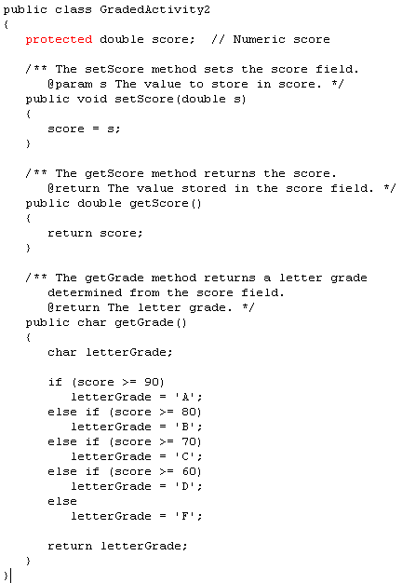
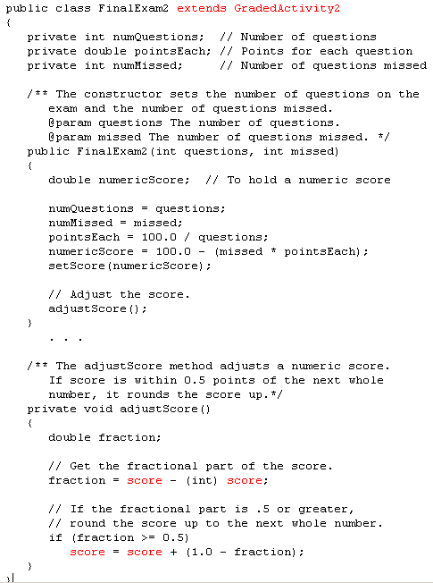

Slide 36
Protected Members
Using protected instead of private makes some tasks easier.
However, any class that is derived from the class, or is in the same package, has unrestricted access to the protected member.
It is always better to make all fields private and then provide public methods for accessing those fields.
If no access specifier for a class member is provided, the class member is given package access by default.
Any method in the same package may access the member.

Slide 37
Access Specifiers
Access Modifier | Accessible to a subclass inside the same package? | Accessible to all other classes inside the same package?
default (no modifier) | Yes | Yes
Public | Yes | Yes
Protected | Yes | Yes
Private | No | No
Access Modifier | Accessible to a subclass outside the package? | Accessible to all other classes outside the package?
default (no modifier) | No | No
Public | Yes | Yes
Protected | Yes | No
Private | No | No

Slide 38
Chains of Inheritance
A superclass can also be derived from another class.
Object
Example: GradedActivity.java PassFailActivity.java PassFailExam.java PassFailExamDemo.java
GradedActivity
PassFailActivity
PassFailExam

Slide 39
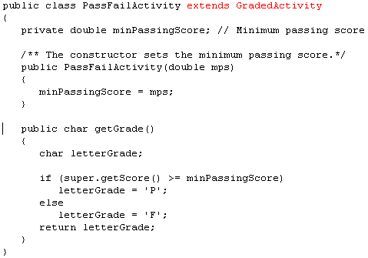
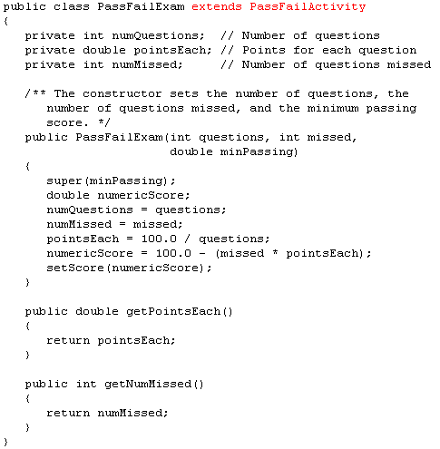
Draw the UML diagram

Slide 41
Chains of Inheritance
Classes often are depicted graphically in a class hierarchy.
A class hierarchy shows the inheritance relationships between classes.
GradedActivity
FinalExam
PassFailActivity
PassFailExam

Slide 42
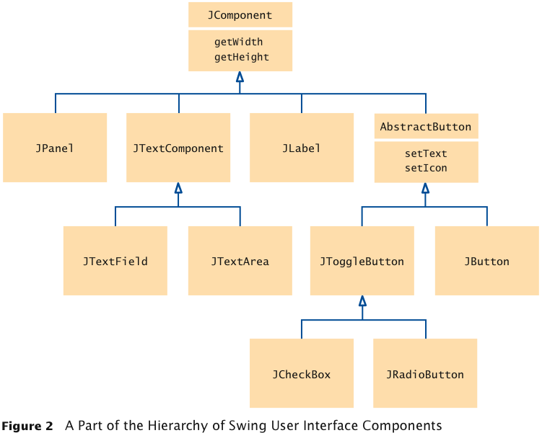
Inheritance Hierarchies
Set of classes can form an inheritance hierarchy
Classes representing the most general concepts are near the root, more specialized classes towards the branches:
Which of the following
have a
setText method
getHeight method
JCheckBox
JTextField
JPanel
Jbutton
JLabel

Slide 43
The Object Class
All Java classes are directly or indirectly derived from a class named Object.
Object is in the java.lang package.
Any class that does not specify the extends keyword is automatically derived from the Object class.
public class MyClass
{
// This class is derived from Object.
}
Ultimately, every class is derived from the Object class.

Slide 44
The Object Class
Because every class is directly or indirectly derived from the Object class:
every class inherits the Object class’s members.
example: toString and equals.
In the Object class, the toString method returns a string containing the object’s class name and a hash of its memory address.
The equals method accepts the address of an object as its argument and returns true if it is the same as the calling object’s address.

Slide 45
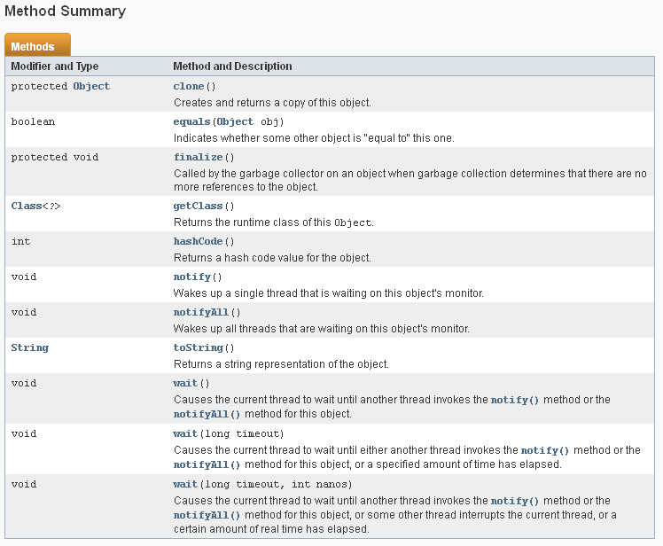
Object class

Slide 46
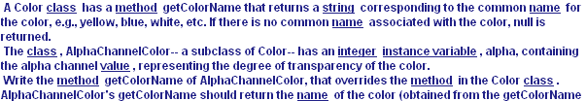

Practice
Draw the UML diagram
Create the AlphaChannelColor class

Slide 47
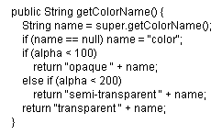

Slide 48
Polymorphism
A reference variable can reference objects of classes that are derived from the variable’s class.
GradedActivity exam;
We can use the exam variable to reference a GradedActivity object.
exam = new GradedActivity();
The GradedActivity class is also used as the superclass for the FinalExam class.
An object of the FinalExam class is a GradedActivity object.

Slide 49
Polymorphism
Based on the following inheritance hierarchy
GradedActivity
FinalExam
PassFailActivity
PassFailExam

Slide 50
Polymorphism
A GradedActivity variable can be used to reference a FinalExam object.
GradedActivity exam = new FinalExam(50, 7);
This statement creates a FinalExam object and stores the object’s address in the exam variable.
This is an example of polymorphism.
The term polymorphism means the ability to take many forms.
In Java, a reference variable is polymorphic because it can reference objects of types different from its own, as long as those types are subclasses of its type.

Slide 51
Polymorphism
GradedActivity
FinalExam
PassFailActivity
Other legal polymorphic references:
GradedActivity exam1 = new FinalExam(50, 7);
GradedActivity exam2 = new PassFailActivity(70);
GradedActivity exam3 = new PassFailExam(100, 10, 70);
The GradedActivity class has three methods: setScore, getScore, and getGrade.
A GradedActivity variable can be used to call only those three methods.
GradedActivity exam = new PassFailExam(100, 10, 70);
System.out.println(exam.getScore()); // This works.
System.out.println(exam.getGrade()); // This works.
System.out.println(exam.getPointsEach()); // ERROR!
PassFailExam

Slide 52
As a GradedActivity reference, only aware of these methods
As a PassFailActivity reference, aware of these methods
This works, but which copy
Of getGrade is used?
GradedActivity exam = new PassFailExam(100, 10, 70);
System.out.println(exam.getScore()); // This works.
System.out.println(exam.getGrade()); // This works.
System.out.println(exam.getPointsEach()); // ERROR!

Slide 53
Polymorphism and Dynamic Binding
If the object of the subclass has overridden a method in the superclass:
If the variable makes a call to that method the subclass’s version of the method will be run.
GradedActivity exam = new PassFailActivity(60);
exam.setScore(70);
System.out.println(exam.getGrade());
Java performs dynamic binding or late binding when a variable contains a polymorphic reference.
The Java Virtual Machine determines at runtime which method to call, depending on the type of object that the variable references.

Slide 54
Polymorphism
It is the object’s type, rather than the reference type, that determines which method is called.
Example:
Polymorphic.java
You cannot assign a superclass object to a subclass reference variable.

Slide 55
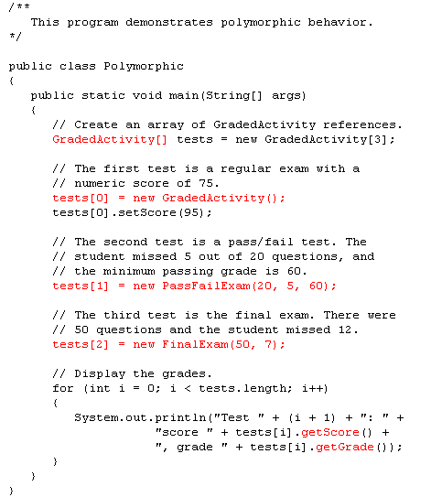
For each object,
which definition
of the methods
is it using?

Slide 56
Abstract Classes
An abstract class cannot be instantiated, but other classes are derived from it.
An Abstract class serves as a superclass for other classes.
The abstract class represents the generic or abstract form of all the classes that are derived from it.
A class becomes abstract when you place the abstract key word in the class definition.
public abstract class ClassName

Slide 57
Abstract Methods
An abstract method has no body and must be overridden in a subclass.
An abstract method is a method that appears in a superclass, but expects to be overridden in a subclass.
An abstract method has only a header and no body.
AccessSpecifier abstract ReturnType MethodName(ParameterList);
Example:
Student.java, CompSciStudent.java, CompSciStudentDemo.java

Slide 58
Abstract Methods
Notice that the key word abstract appears in the header, and that the header ends with a semicolon.
public abstract void setValue(int value);
Any class that contains an abstract method is automatically abstract.
If a subclass fails to override an abstract method, a compiler error will result.
Abstract methods are used to ensure that a subclass implements the method.

Slide 59
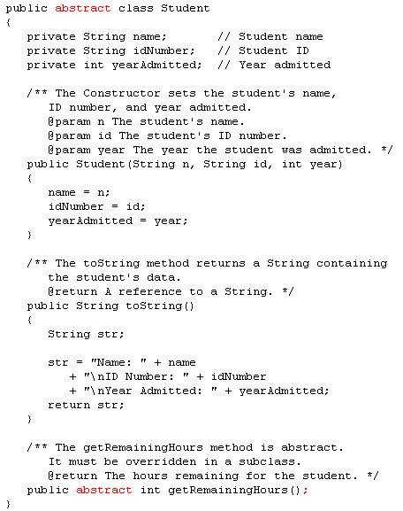

Slide 60
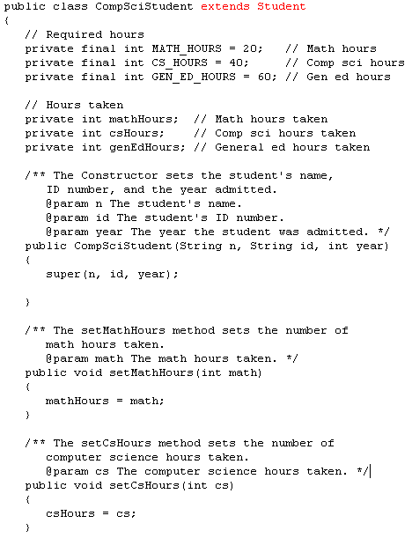
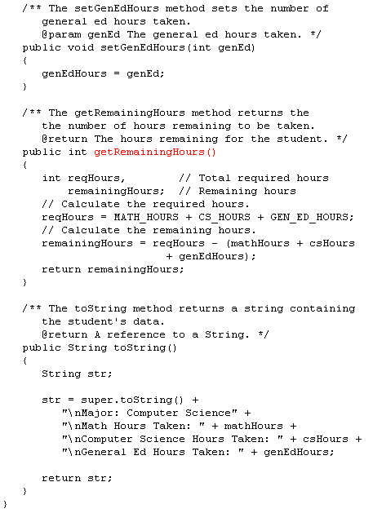
Draw the UML diagram?

Slide 61
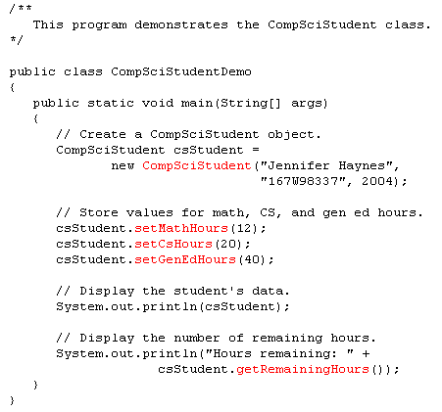
What is the output?

Slide 62
The (abstract) class DesktopComponent contains an abstract method named onClicked that is void-returning and accepts no parameters . Provide the declaration of this method .
public abstract void onClicked();

Slide 63
Polymorphism via Abstract Methods
Consider the following class hierarchy:
StaffMember
Volunteer
Employee
Executive
Hourly

Slide 64
//******************************************************
// StaffMember.java Author: Lewis/Loftus
//
// Represents a generic staff member.
//**************************************************
abstract public class StaffMember
{
protected String name;
protected String address;
protected String phone;
//-----------------------------------------------------------------
// Constructor: Sets up this staff member using the specified
// information.
//-----------------------------------------------------------------
public StaffMember (String eName, String eAddress, String ePhone)
{
name = eName;
address = eAddress;
phone = ePhone;
}
StaffMember
{abstract}
# name : String
# address : String
# phone: String
+ toString() : String
+ pay() : double {abstract}
//-----------------------------------------------------------------
// Returns a string including the basic employee information.
//-----------------------------------------------------------------
public String toString()
{
String result = "Name: " + name + "\n";
result += "Address: " + address + "\n";
result += "Phone: " + phone;
return result;
}
//-----------------------------------------------------------------
// Derived classes must define the pay method for each type of
// employee.
//-----------------------------------------------------------------
public abstract double pay();
}

Slide 65
//********************************************************************
// Volunteer.java Author: Lewis/Loftus
//
// Represents a staff member that works as a volunteer.
//********************************************************************
public class Volunteer extends StaffMember
{
//-----------------------------------------------------------------
// Constructor: Sets up this volunteer using the specified
// information.
//-----------------------------------------------------------------
public Volunteer (String eName, String eAddress, String ePhone)
{
super (eName, eAddress, ePhone);
}
//-----------------------------------------------------------------
// Returns a zero pay value for this volunteer.
//-----------------------------------------------------------------
public double pay()
{
return 0.0;
}
}
StaffMember
{abstract}
# name : String
# address : String
# phone: String
+ toString() : String
+ pay() : double {abstract}
Volunteer
+ pay() : double

Slide 66
//********************************************************************
// Employee.java Author: Lewis/Loftus
//
// Represents a general paid employee.
//********************************************************************
public class Employee extends StaffMember
{
protected String socialSecurityNumber;
protected double payRate;
//-----------------------------------------------------------------
// Constructor: Sets up this employee with the specified
// information.
//-----------------------------------------------------------------
public Employee (String eName, String eAddress, String ePhone,
String socSecNumber, double rate)
{
super (eName, eAddress, ePhone);
socialSecurityNumber = socSecNumber;
payRate = rate;
}
//-----------------------------------------------------------------
// Returns information about an employee as a string.
//-----------------------------------------------------------------
public String toString()
{
String result = super.toString();
result += "\nSocial Security Number: " + socialSecurityNumber;
return result;
}
//-----------------------------------------------------------------
// Returns the pay rate for this employee.
//-----------------------------------------------------------------
public double pay()
{
return payRate;
}
}
StaffMember
{abstract}
# name : String
# address : String
# phone: String
+ toString() : String
+ pay() : double {abstract}
Employee
# socialSecurityNumber : String
# payRate : double
+ toString() : String
+ pay() : double

Slide 67
//********************************************************************
// Hourly.java Author: Lewis/Loftus
//
// Represents an employee that gets paid by the hour.
//********************************************************************
public class Hourly extends Employee
{
private int hoursWorked;
//-----------------------------------------------------------------
// Constructor: Sets up this hourly employee using the specified
// information.
//-----------------------------------------------------------------
public Hourly (String eName, String eAddress, String ePhone,
String socSecNumber, double rate)
{
super (eName, eAddress, ePhone, socSecNumber, rate);
hoursWorked = 0;
}
//-----------------------------------------------------------------
// Adds the specified number of hours to this employee's
// accumulated hours.
//-----------------------------------------------------------------
public void addHours (int moreHours)
{
hoursWorked += moreHours;
}
//-----------------------------------------------------------------
// Returns information about this hourly employee as a string.
//-----------------------------------------------------------------
public String toString()
{
String result = super.toString();
result += "\nCurrent hours: " + hoursWorked;
return result;
}
}
//-----------------------------------------------------------------
// Computes and returns the pay for this hourly employee.
//-----------------------------------------------------------------
public double pay()
{
double payment = payRate * hoursWorked;
hoursWorked = 0;
return payment;
}
StaffMember
{abstract}
# name : String
# address : String
# phone: String
name
address
phone
socialSecurityNumber
payRate
hoursWorked
+ toString() : String
+ pay() : double {abstract}
Employee
# socialSecurityNumber : String
# payRate : double
+ toString() : String
+ pay() : double
What data
members does
hourly have
direct access to?
Hourly
- hoursWorked : int
+ toString() : String
+ pay() : double
+ addHours(int) : void

Slide 68
//********************************************************************
// Executive.java Author: Lewis/Loftus
//
// Represents an executive staff member, who can earn a bonus.
//********************************************************************
public class Executive extends Employee
{
private double bonus;
//-----------------------------------------------------------------
// Constructor: Sets up this executive with the specified
// information.
//-----------------------------------------------------------------
public Executive (String eName, String eAddress, String ePhone,
String socSecNumber, double rate)
{
super (eName, eAddress, ePhone, socSecNumber, rate);
bonus = 0; // bonus has yet to be awarded
}
//-----------------------------------------------------------------
// Awards the specified bonus to this executive.
//-----------------------------------------------------------------
public void awardBonus (double execBonus)
{
bonus = execBonus;
}
//-----------------------------------------------------------------
// Computes and returns the pay for an executive, which is the
// regular employee payment plus a one-time bonus.
//-----------------------------------------------------------------
public double pay()
{
double payment = super.pay() + bonus;
bonus = 0;
return payment;
}
}
StaffMember
{abstract}
# name : String
# address : String
# phone: String
+ toString() : String
+ pay() : double {abstract}
Employee
# socialSecurityNumber : String
# payRate : double
+ toString() : String
+ pay() : double
Executive
- bonus : double
+ awardBonus(double) : void
+ pay() : double

Slide 69
StaffMember
{abstract}
# name : String
# address : String
# phone: String
+ toString() : String
+ pay() : double {abstract}
Volunteer
Employee
# socialSecurityNumber : String
# payRate : double
+ pay() : double
+ toString() : String
+ pay() : double
Hourly
Executive
- hoursWorked : int
- bonus : double
+ toString() : String
+ pay() : double
+ addHours(int) : void
+ awardBonus(double) : void
+ pay() : double

Slide 70
//********************************************************************
// Staff.java Author: Lewis/Loftus
//
// Represents the personnel staff of a particular business.
//********************************************************************
public class Staff
{
private ArrayList <StaffMember> staffList;
//-----------------------------------------------------------------
// Constructor: Sets up the list of staff members.
//-----------------------------------------------------------------
public Staff ()
{
staffList = new ArrayList<StaffMember>();
staffList.add(new Executive ("Sam", "123 Main Line",
"555-0469", "123-45-6789", 2423.07);
staffList.add(new Employee ("Carla", "456 Off Line",
"555-0101", "987-65-4321", 1246.15);
staffList[.add(new Employee ("Woody", "789 Off Rocker",
"555-0000", "010-20-3040", 1169.23);
staffList.add(new Hourly ("Diane", "678 Fifth Ave.",
"555-0690", "958-47-3625", 10.55);
staffList.add(new Volunteer ("Norm", "987 Suds Blvd.",
"555-8374");
staffList.add(new Volunteer ("Cliff", "321 Duds Lane",
"555-7282");
((Executive)staffList.get(0)).awardBonus (500.00);
((Hourly)staffList.get(3)).addHours (40);
}
//-----------------------------------------------------------------
// Pays all staff members.
//-----------------------------------------------------------------
public void payday ()
{
double amount;
for (StaffMember s : staffList)
{
System.out.println (s);
amount = s.pay(); // polymorphic
if (amount == 0.0)
System.out.println ("Thanks!");
else
System.out.println ("Paid: " + amount);
System.out.println ("-----------------------------------");
}
}
}
Exec
Sam
Emp
Carla
Emp
Woody
Hrly
Diane
Vol
Norm
Vol
Cliff

Slide 71
//****************************************************
// Firm.java Author: Lewis/Loftus
//
// Demonstrates polymorphism via inheritance.
//****************************************************
public class Firm
{
//-----------------------------------------------------------------
// Creates a staff of employees for a firm and pays them.
//-----------------------------------------------------------------
public static void main (String[] args)
{
Staff personnel = new Staff();
personnel.payday();
}
}
What is output?

Slide 72
Name: Sam
Address: 123 Main Line
Phone: "555-0469
Social Security Number: 123-45-6789
Paid: 2923.07
________________________
Name: Carla
Address: 456 Off Line
Phone: 555-0101
Social Security Number: "987-65-4321
Paid: 1246.15
________________________
Name: Woody
Address: 789 Off Rocker
Phone: 555-0000
Social Security Number: "010-20-3040
Paid: 1169.23
________________________
Name: Diane
Address: 678 Fifth Ave.
Phone: 555-0690
Social Security Number: 958-47-3625
Current hours: 40
Paid: 422.00
________________________
Name: Norm
Address: 987 Suds Blvd.
Phone: 555-8374
Thanks!
________________________
Name: Cliff
Address: 321 Duds Lane
Phone: "555-7282
Thanks!
________________________

